Slide 1


Welcome to Year 5’s
Meet the Teacher

Slide 2
Meet the Year __ Team
Teachers | Teaching assistants | Interventions
Miss Kyne Mrs Kelliher (Monday afternoon) | Mrs Aspart (Mornings only ) | Miss Beardsworth (Miss B) Miss B will be running some intervention groups in the rainbow room opposite the year 5 classroom on Monday, Tuesday and Friday afternoons. These interventions will cover subjects such as maths, reading, SPaG, writing, handwriting and spelling.

Slide 3
Key Information
Registration | Lesson 1 | Lesson 2 | Break | Lesson 3 | Lunch | Lesson 4 | Lesson 5 | End of the day
8:45am Soft start | Whole class Reading/Assembly | English | 10:30-10:45am | Maths | 12-1pm | RE | Science | Story/end of day prayer 3:20pm
PE Days | Forest School
Tuesday Thursday | Forest school will be on a Tuesday this year. The children will have 5 sessions over the year. The dates for forest school will be published on class dojo.
Notes:
This is an overview of our school times throughout the day and here is an example timetable, as you can see – school days are very busy so it is no surprise very tired children come home! Our PE days this half term are _____________.
Forest School dates for the year are _______

Slide 4
Homework
Reading | Times tables | Spelling | Maths/SPaG
All children should be reading daily at home. When you read with your child please record this in their reading record. The children can also write in their own record if they read at home. Please make sure the date is written. An adult must sign their child’s reading record at least once a week. Reading records and reading books must be in school everyday. Reading records will be checked when a member of staff reads with your child and every Friday morning by the class TA. | All children should aim to practice their timetables using TTRS for 5-10 minutes 5 days a week. Your child has a sticker with their TTRS login information in their reading record. TTRS use is monitored by the class teacher. | Each child will have a purple spelling book. Every Friday morning there will be a spelling test. The children must bring their purple book into school for this on Friday and to stick their new spellings in. The children will have 10 words to learn each week that cover spellings from the national curriculum. The children should aim to practice their spellings daily. | Every Friday the children will be given a double sided sheet that contains one maths task and one SPaG task. The children will have a week to complete this sheet and it must be handed back in the following Friday. The children can hand their homework sheet in early if they wish to do so.

Slide 5
Curriculum
Subject area | Autumn topics | Spring topics | Summer topics
English Whole class reading | Narrative writing Newspaper reports Biography writing | Narrative writing Persuasive writing Balanced arguments | Narrative writing Non-chronological report Poetry
Maths | Place value Addition and subtraction Multiplication and division A Fractions A | Multiplication and division B Fractions B Decimals and percentages Perimeter and area Statistics | Shape Position and direction Decimals Negative numbers Converting units Volume
RE | Creation and covenant Prophecy and promise | Galilee to Jerusalem Desert to Garden | To the ends of the earth Dialogue and Encounter
Science | Properties and changes of materials. | Forces Earth and space | In summer 2 at the end of year the children will learn about sexual reproduction and puberty in science. This is mandatory as it is part of the national curriculum. Living things and their habitats Animals including humans

Slide 6
Curriculum continued
Subject area | Autumn topics | Spring topics | Summer topics
Geography History | What is life like in the Alps? The Vikings | Why do oceans matter? The Tudors | Would you like to live in the desert? Ancient Greece
PE | Netball Gymnastics Football Health related exercises | Basketball Dance Hockey OAA: Communication | Striking and fielding Tennis Cricket Athletics
Computing | Computer systems and networks Data and information | Creating media | Programming
Music | Bumper harvest Bells ring out | Living on a prayer Fresh prince of Bel-Air | Staying healthy Reflect, rewind and replay.
Art Design and technology | Autumn 1- Drawing: Depth, emotion and movement. Autumn 2- Gears and pulleys | Spring 1- Painting and mixed media. Spring 2- Stuffed toys | Summer 1- Sculpture and 3D: Interactive installations. Summer 2-Creating a pasta dish.
French | Ice creams The weather | At the tea room In the classroom | My home Habitats
PSHE | Created to love others part 1 | Created to love others part 2 | Created to live in community

Slide 7

Enrichment opportunities
Residential trip (There will be a parent meeting in the spring term, I will inform you of the date nearer the time.)
Hazard alley trip (January)
Sports trips/events.
Young voices if your child is in the choir.
Dacorum dance competition in the spring term.
History dress up days.
Notes:
Enrichment in Year _____ is………………….
Trips, competitions etc..that you know ARE happening. – E.G. Y5& 6 RESIDENTIAL,

Slide 8
Assessment
Towards the end of every term the children will sit assessments in Maths, SPaG (spelling, punctuation and grammar) as well as reading.
These assessments are sat 3 times a year.
In the summer term the children will also sit their first set of mock SATS to prepare them for year 6, this also helps to inform the year 6 class teacher of where the children are working at.
In writing the children complete an independent piece of writing at the end of each English unit. This piece of independent work is then assessed by the class teacher. The children will complete 2/3 different units of work per half term.

Slide 9
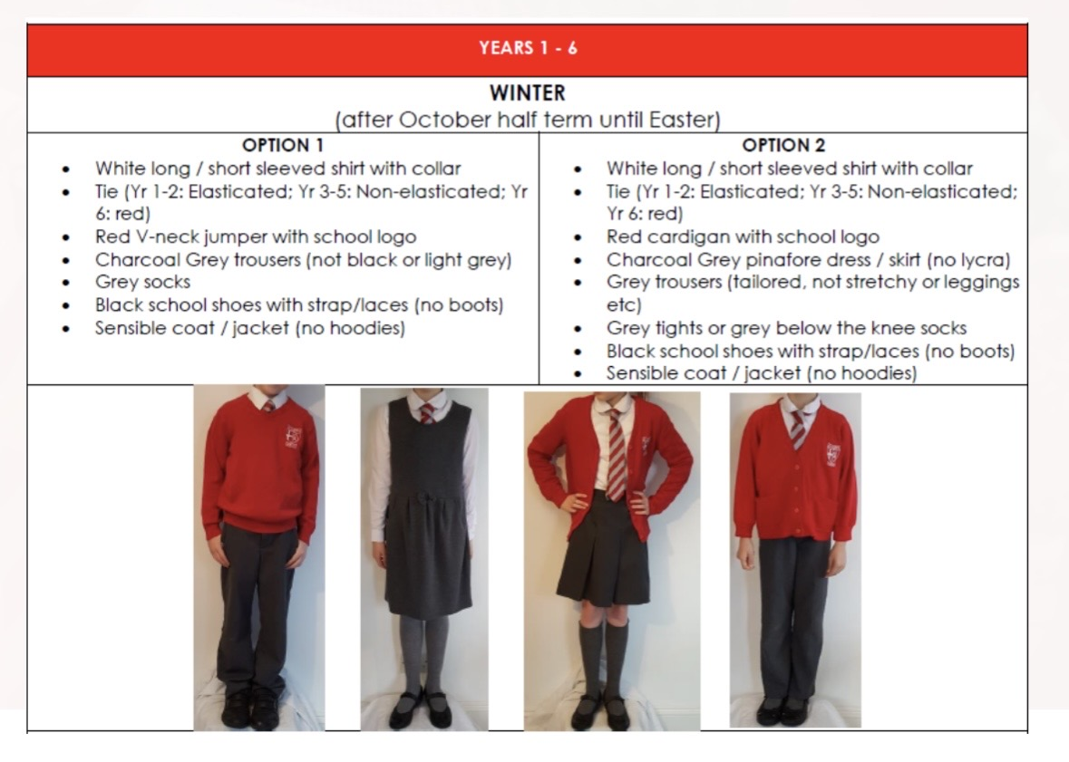
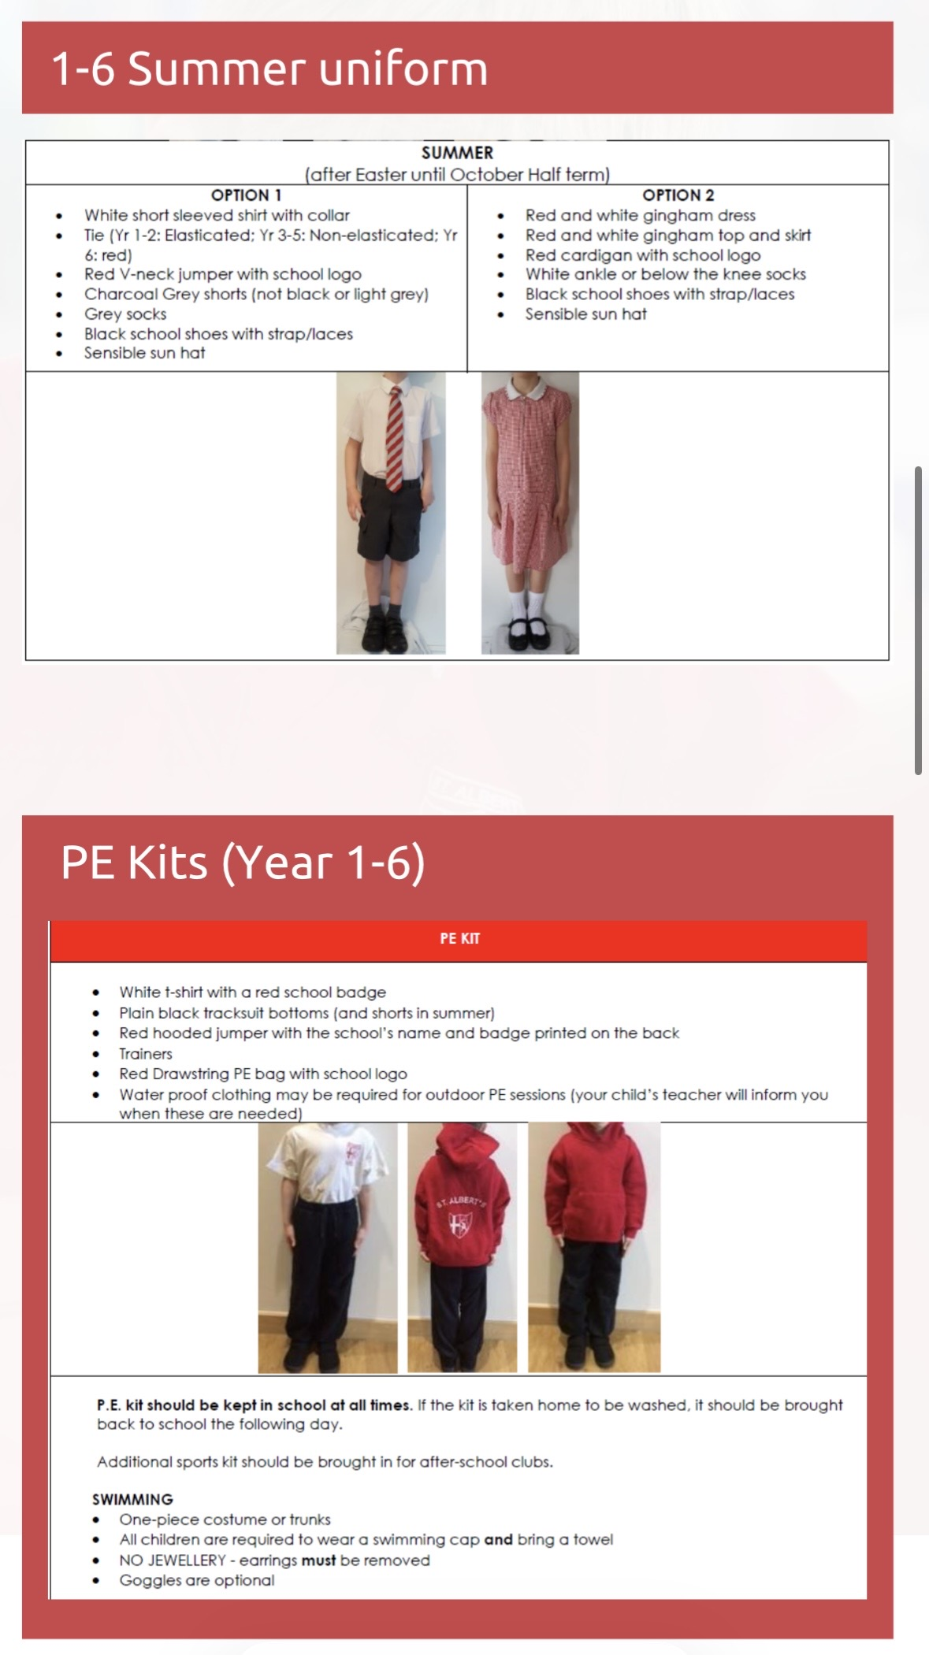
Uniform
Notes:
In year ________ we wear _________
PE kits consist of ______

Slide 10
Uniform
Notes:
In year ________ we wear _________
PE kits consist of ______

Slide 11

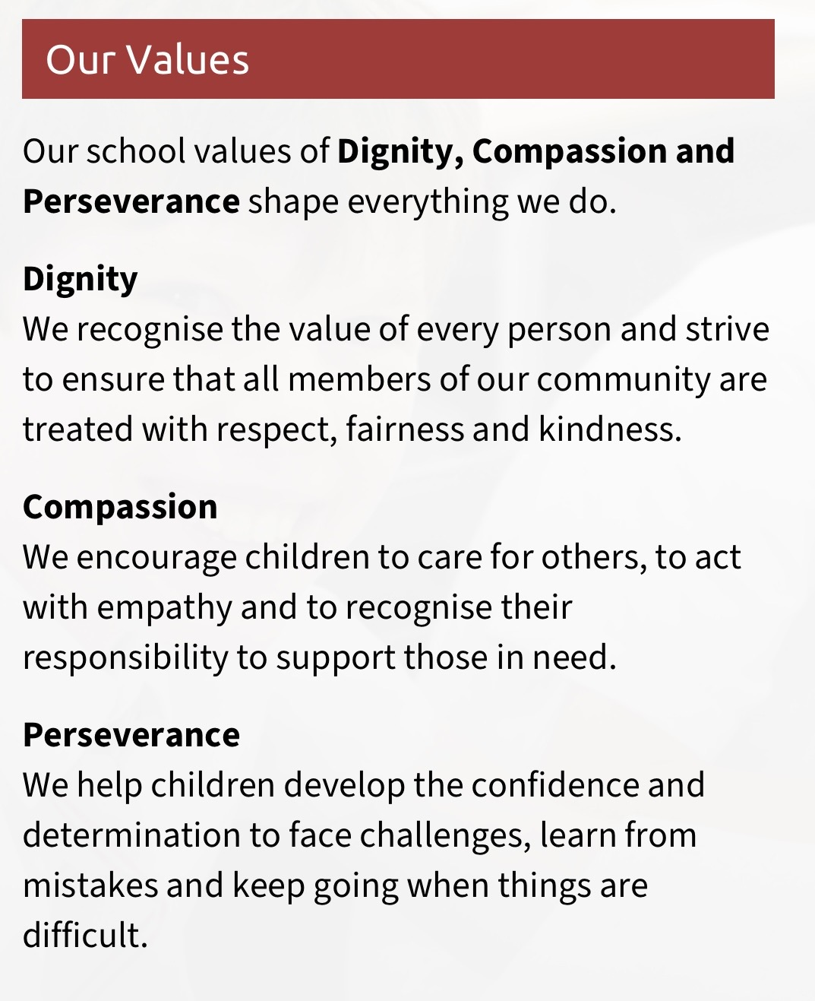
School mission and values
‘The more I learn about the world in which I live, the closer I grow to God’
Prayers to reinforce at home:
Our Father, Hail Mary, Glory Be, responses and key prayers used in Mass (Gloria, Creed etc.)

Slide 12
How to get in contact:
When to email | When to use class dojo
Email - admin@albertthegreat.herts.sch.uk To inform of any appointments. To inform of any changes to pick up or drop off. To inform about breakfast club or afterschool club. Anything attendance related. Any concerns Must be emailed into the office with the subject ‘for the attention of Miss Kyne’ and Not sent via class dojo. This is so that the school has a formal record of your concern and that it can be dealt with promptly. Any concerns will not be address on class dojo, this will be done via a telephone call, an in person meeting or a response to the email itself. Please also come and speak to me at pick up if you have any questions, concerns or anything else you wish to discuss. | To share any achievements outside of school. General questions about school work, classroom events or whole school events. To inform me of lost items or uniform. Class dojo is not checked daily.
If your message requires an urgent response or before the end of the school day please ensure you phone the school.

Slide 13

Questions?
Feel free to ask now or speak to me afterwards

